Slide 1


Problem Solving with the Internet of Things and Python
Unit 4 - BLE Connectivity
Notes:
Note from Doug. If you are using these materials, you can remove the CWRU logo and replace it with your own, but please retain the CC-BY logo on the first page as well as retain the acknowledgements page(s).

Slide 2
Lab 8
BLE with an MQTT gateway

Slide 3
BLE with an MQTT gateway
Until now, you have not connected your IoT device to the internet.
In Lab 8, you will use the Adafruit Bluefruit LE App on your phone as a gateway to the internet.

Slide 4
Benefits of MQTT
requires little overhead - can be run on microcontrollers
connects quickly
bi-directional communication
has a pub/sub model
has multiple levels of message delivery - QoS
has persistent connections

Slide 5
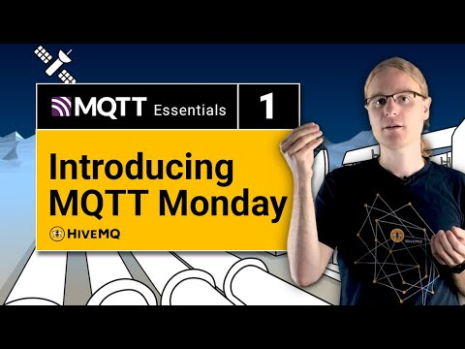
A little MQTT History

Slide 6

MQTT Main Features

Slide 7

MQTT Pub/Sub model

Slide 8
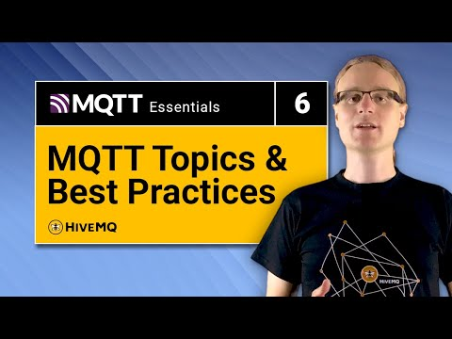
MQTT Topics

Slide 9
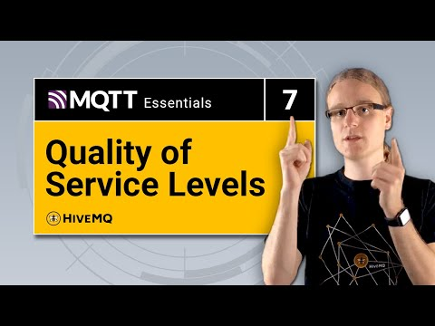
MQTT Quality of Service

Slide 10
MQTT Topics

Slide 11
That’s a lot about MQTT
Thankfully, Adafruit again provides us the necessary tools to make the task of programming the Feather Sense to be a MQTT client pretty straight forward. We shall see in Lab 8.
But, what is our broker?

Slide 12
Adafruit IO Service - our MQTT broker
Adafruit IO
Your instructor will now walk you through the steps to create a new free Adafruit IO account!

Slide 13
More resources
https://learn.adafruit.com/mqtt-adafruit-io-and-you
https://randomnerdtutorials.com/what-is-mqtt-and-how-it-works/
Complete HiveMQ Playlist
Adafruit IO video
Complete BLE video series

